Slide 1

SCTP Assoc AI/ML Developer:
Capstone Project
Log Classification
C2

Slide 2
Overview
Project Purpose
To classify IT system logs using a Random Forest Classifier (RFC), improving automation in log management
Objectives:
Build a reliable baseline model with efficient resource use.
Understand the model’s performance on log data and identify areas for improvement.
Explore the potential of advanced techniques for future log analysis and intelligent automation
Key Focus:
Achieving robust classification results while addressing the challenges of pre-processing and feature engineering for large-scale log data

Slide 3
Rationale
Logs are closely related to IT environment
come in many formats,
generated in large quantity, and
at immense velocity
almost impossible to digest it for timely actions
Machine Learning could be the solution
Random Forest Classifier algorithm is selected for:
handle high-dimensional datasets without overfitting
rank feature importance
maintain acceptable level of interpretability (important in a cybersecurity environment)
Notes:
ability to handle high-dimensional datasets without overfitting, as it uses multiple decision trees and combine their outputs
able to rank feature importance to understand which features contribute most to specific outcome
Effective monitoring is essential for also ensuring compliance with regulatory standards and safeguarding sensitive information, ultimately protecting both the organization's assets and its
Application Understanding:
The potential for applying machine learning to log data is vast, the entire software value chain produces logs of some sort and that offers great opportunities for players large and small to value-add
Ultimately, the aim is for decision-making processes to be automated as much as possible, minimized manual effort and improve efficiency at preventing issues from escalating.reputation.

Slide 4
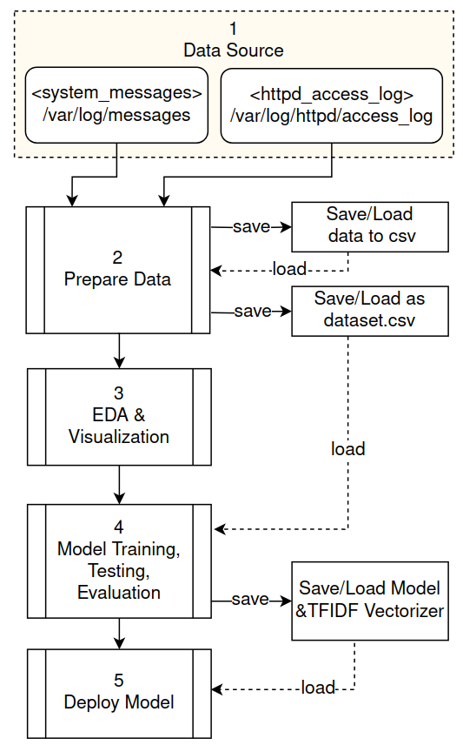
System Architecture and Design (1/2)
1. Raw logs are obtained (as tar ball) from the publicly hosted “log-sharing” site (http://log-sharing.dreamhosters.com);
web logs (/var/log/httpd/access_log*)
system logs (/var/log/messages*)
2. Prepare Data:
collected, formated, & consolidated
data cleaning, normalization, and combined into 1 CSV dataset
feature extracted (eg datetime value)
logs are labeled
Notes:
Persisting artifacts such the interim csv data files at each appropriate stage,
eg after pre-processing a copy of the respective log data is saved and
after EDA, all log data is combined, a copy saved as 1 dataset csv file for loading into the model for training.
Finally after the training is complete, the model and the vectorizer are saved so that subsequent development of the inference logic can continue without the need to run entire notebook from start.
#3
pd.concat() was used to combined into 1 dataframe
thereafter, df.sample(frac=1) is used to “shuffle” the dataframe’s records to induce a pseudo randomness
this is required as later during the model training, the GridSearchCV() object does not shuffle the train test split during the 5 fold cross validation process

Slide 5
System Architecture and Design (1/2)
3. Exploratory Data Analysis
EDA with Visualization were performed to better understand the dataset’s characteristics such as message length and word count
4. Model Training & T
Random Forest Classifier is trained with different sets of hyperparameters;
metrics: accuracy, precision, recall, F1-score
5. Deployment
the inference UI implemented using Gradio
an offline/local inference mode is available
Notes:
initial attempted hyperparameters were later tuned down, as it keep crashing colab runtime (due to out of memory)
feature selection is random and automatic per the hyperparameters

Slide 6
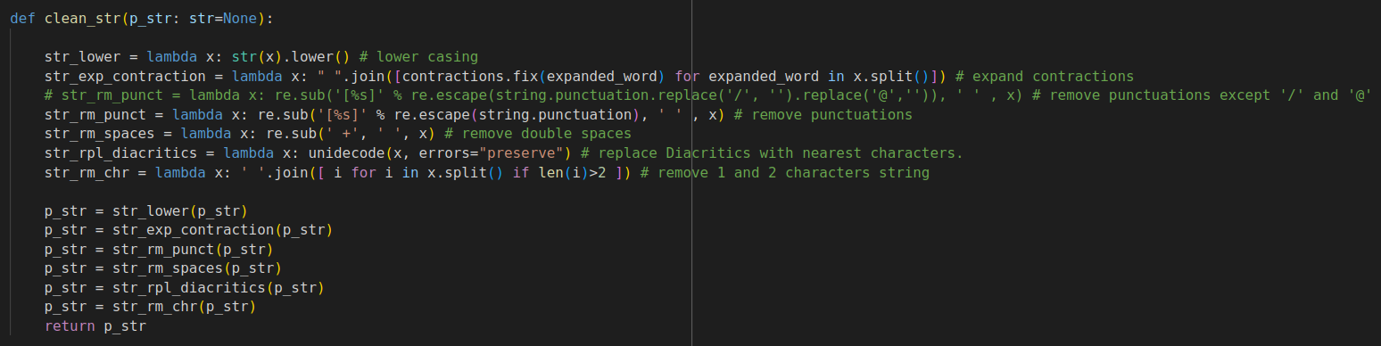
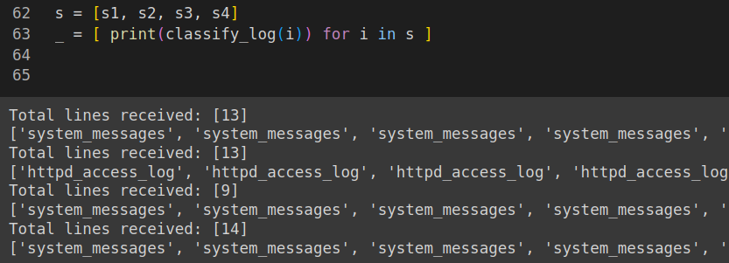
Coding Highlights
lambda functions are used extensively to clean data/string
list comprehension
functions
notebook interoperability

Slide 7
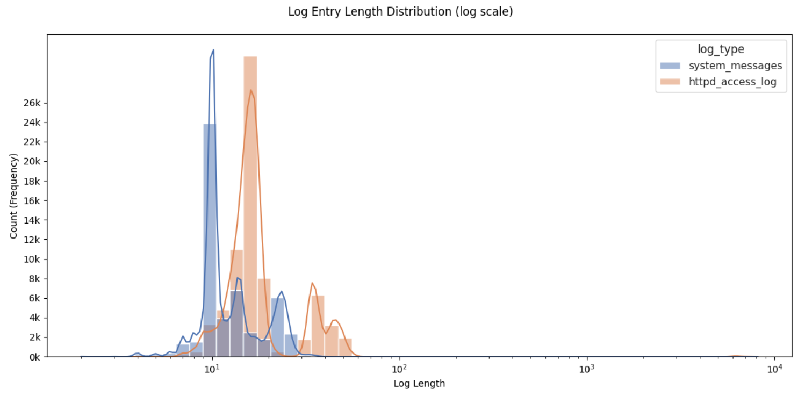
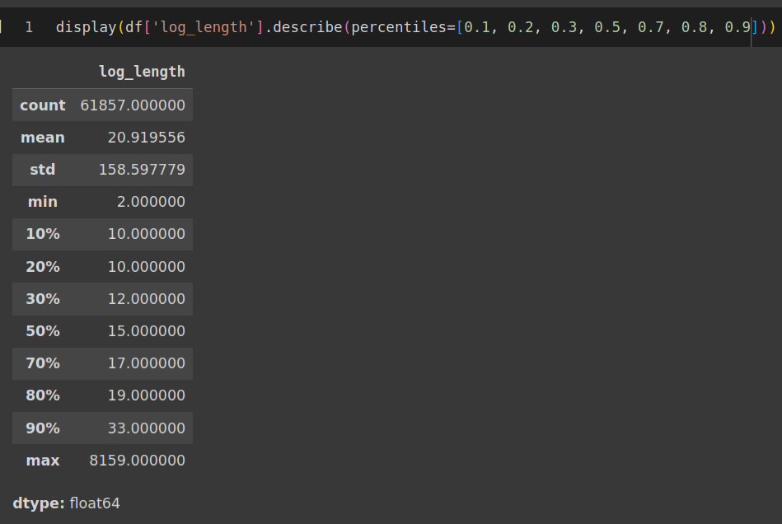
Exploratory Data Analysis (1/2)
Chart (in log scale) shows an apparent difference in entry length between the 2 log types
However, if omitting both the peaks A and B, both log types do have similar log length distribution characteristics
A
B

Slide 8
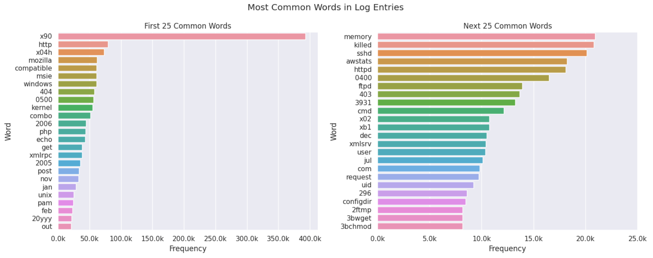
Exploratory Data Analysis (2/2)
Chart shows top 25 common words, though many of them are single and double char ‘word’ should be removed before model training
Do note: 1 and 2 char words are removed during the data cleaning process, as they are really not meaningful

Slide 9
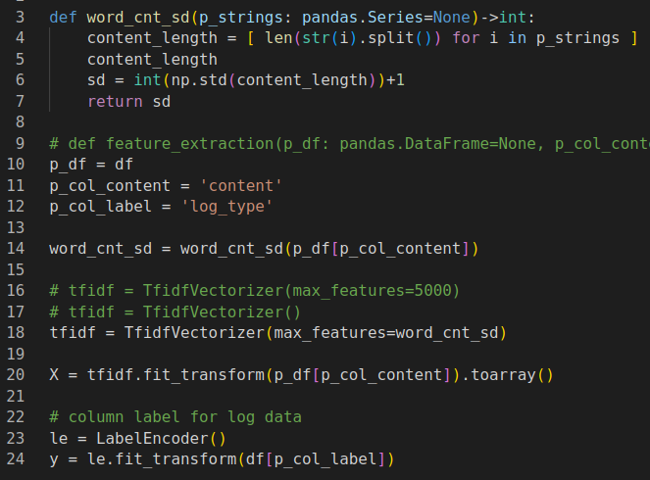
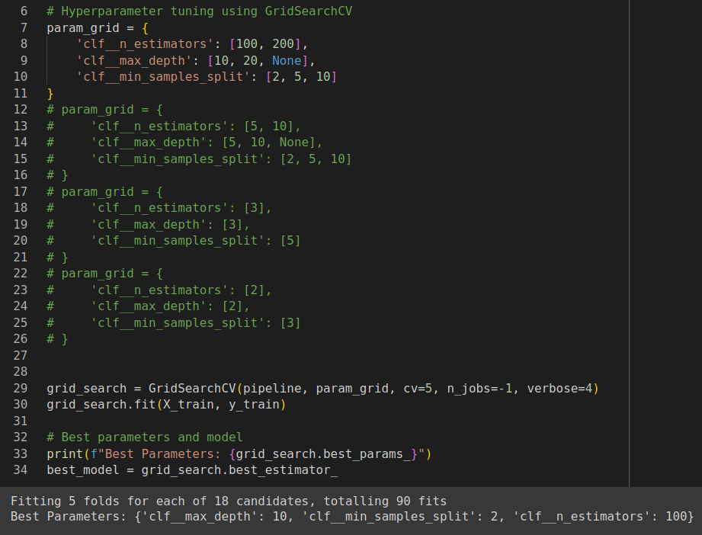
Model Training & Tuning
Hyperparameters
param_grid
cv = 5
num of folds for cross validation
jobs = -1
set the num of CPU for training
most hyperparameters sets works fine
size of vectorizer is pivotal
Notes:
GridSearchCV, RandomizedSearchCV

Slide 10
Tuning
Hyperparameters/Trail | T-1 | T-2 | T-3 | T-4*
clf__n_estimators | [2] | [50,80,120] | [100,200] | ~
clf__max_depth | [2] | [5,10,None] | [10,20,None] | ~
clf__min_sample_split | [3] | [2,5,10] | [2,5,10] | ~
cv | 5 | 5 | 5 | ~
n_jobs (-1:all cpu) | -1 | -1 | -1 | 2
Summary | Fitting 5 folds for each of 1 candidates, totalling 5 fits | Fitting 5 folds for each of 27 candidates, totalling 135 fits | Fitting 5 folds for each of 18 candidates, totalling 90 fits | ~
Time taken | 0.4s | 2min 14s | 2min 59s | 3min 53s
Best Parameters: 'clf__max_depth': 'clf__min_samples_split': 'clf__n_estimators': | 2, 3, 2 | 5, 2, 120 | 10, 2, 100 | Not captured
* T-4 demonstrates using same settings as T-3, but limit to only 2 CPU threads, and training took longer than T-3.
~ denotes same parameters as T-3
Machine Specs: Linux, 8 CPU, 16GB RAM

Slide 11
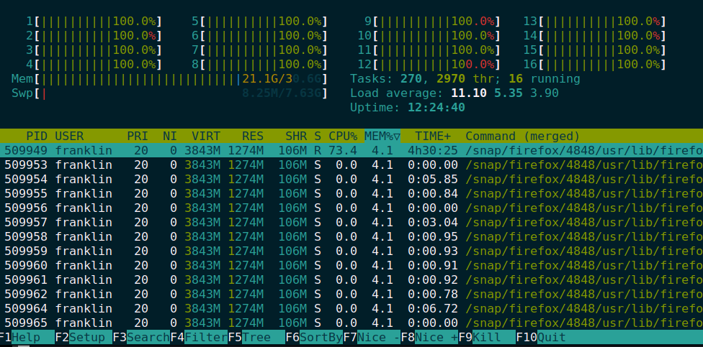

Slide 12
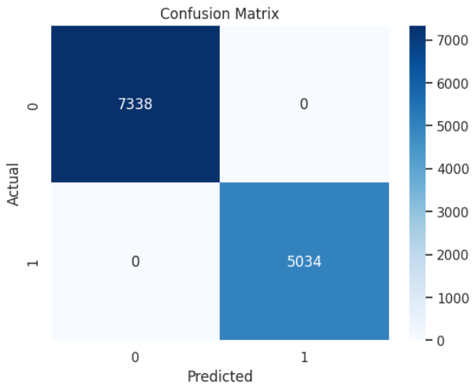
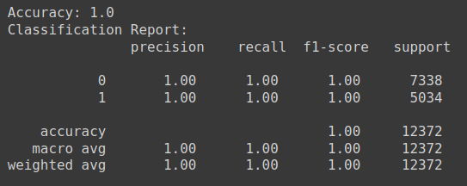
Testing Results
Testing Process:
GridSearchCV
Results:
Accuracy: 1.0
F1-score: 1.0

Slide 13
Model Evaluation
Accuracy score: 1
correct classification is crucial as it affects downstream decision process
F1 Score: 1
F1 Score is the next important metric, as the dataset is somewhat imbalance (uneven class distribution)
`access_log` has a third more entries than `messages` log by over 40% /content/messages line count: 25567 /content/access_log line count: 36310

Slide 14
Validation
A total of 46 log entries were introduced to the offline inference test setup
Accuracy drops to 76% with 11 wrong predictions
Possible causes:
small validation dataset (only 46 entries)
training data itself may be short on diversity

Slide 15
Limitations
the data ingestion stage requires custom processing for each new log type
some info are lost when the vectorizer is initialized at a much lower value compared the longest log length

Slide 16
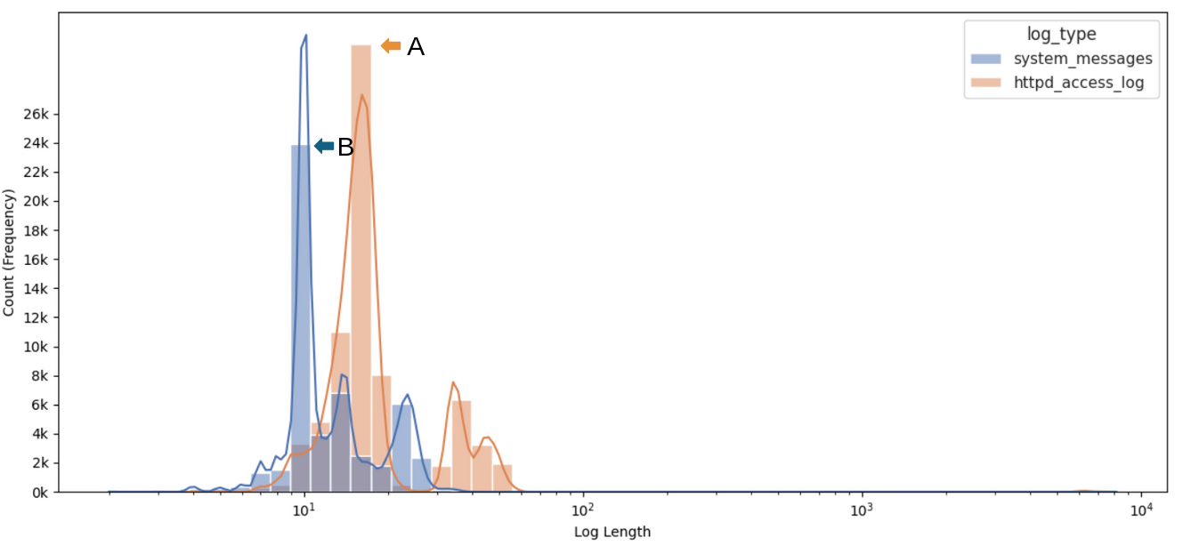
Challenges #1
At times, visualization/plot may not be as intuitive to indicate outliers
Root Cause: A log scale histogram plot was’t apparent on the implication such extremely lengthy log entry, skewing the entire plot
Fix:
finally realizing that “empty” space
use `df.describe(percentiles=[0.1, 0.2, 0.3, 0.5, 0.7, 0.8, 0.9])` to show a fine grain distribution in text
this lead to identifying using the SD of “entry log length” to initialize the vectorizer in Challenge#1

Slide 17
Challenges #2
the notebook environment keeps crashing with “out of memory” during model training
Root Cause: From the EDA on Log Entry Length, some entry length can be over 8000 words long. With a dataset of over 61k lines, we will have a huge TfidfVectorizer (8k x 49k) (X_train.shape)
Fix:
Initialize the TfidfVectorizer to a reasonable value max_features=(word count SD) instead of using TfidfVectorizer() which default to use all words found

Slide 18
Conclusion and Future Work
Achievement:
The Log Classification model can achieved over 70% accuracy using a Random Forest Classifier
Insights:
Data Ingestion stage need a better strategy
Data pre-processing and EDA should improved with experience
Need to improve on detecting & managing outliers in the dataset
Future enhancements:
vary the TfidfVectorizer initial value during tuning
Explore XGBoost for comparison.
Incorporate larger and more diverse datasets.
Explore using deep learning techniques for better data ingestion capabilities

Slide 19
Q&A
Notes:
Be Prepared: Anticipate questions related to the project's methodology, results, and potential applications.
Provide Clear and Concise Answers: Demonstrate a deep understanding of the subject matter and your ability to communicate effectively.

Slide 20
Thank You
SCTP Assoc AI/ML Developer
C2

Slide 21
The End

Slide 22
list comprehension
for manipulating pandas series column data and pretty handy for anonymous operations too
coding conventions (PEP-8) (not all the time)
modular coding using module functions
notebook is structured to be interoperable between colab and kaggle

Slide 23
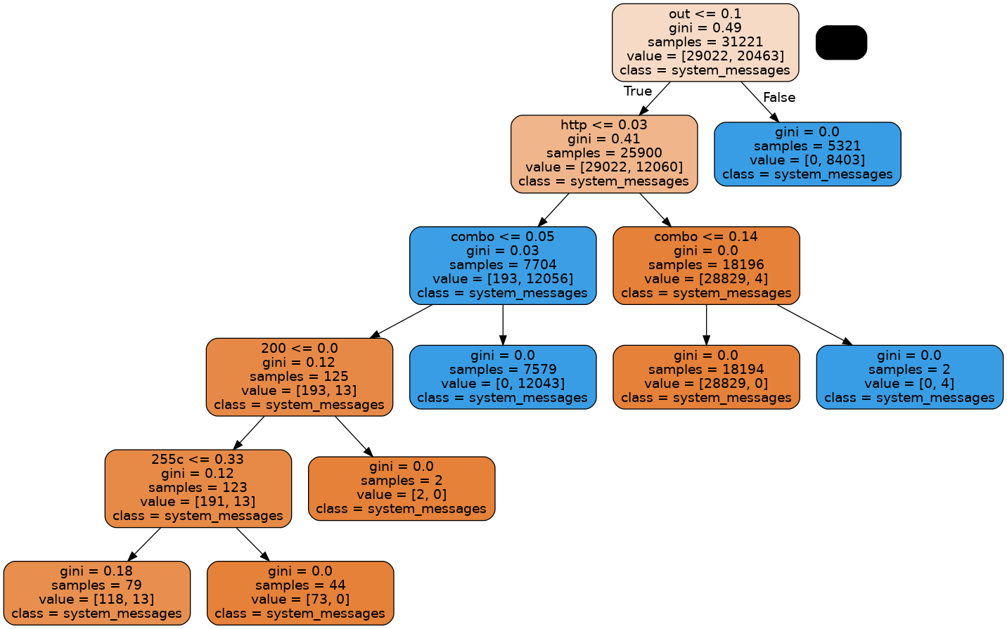
Sample Decision Tree Visualization

Slide 24
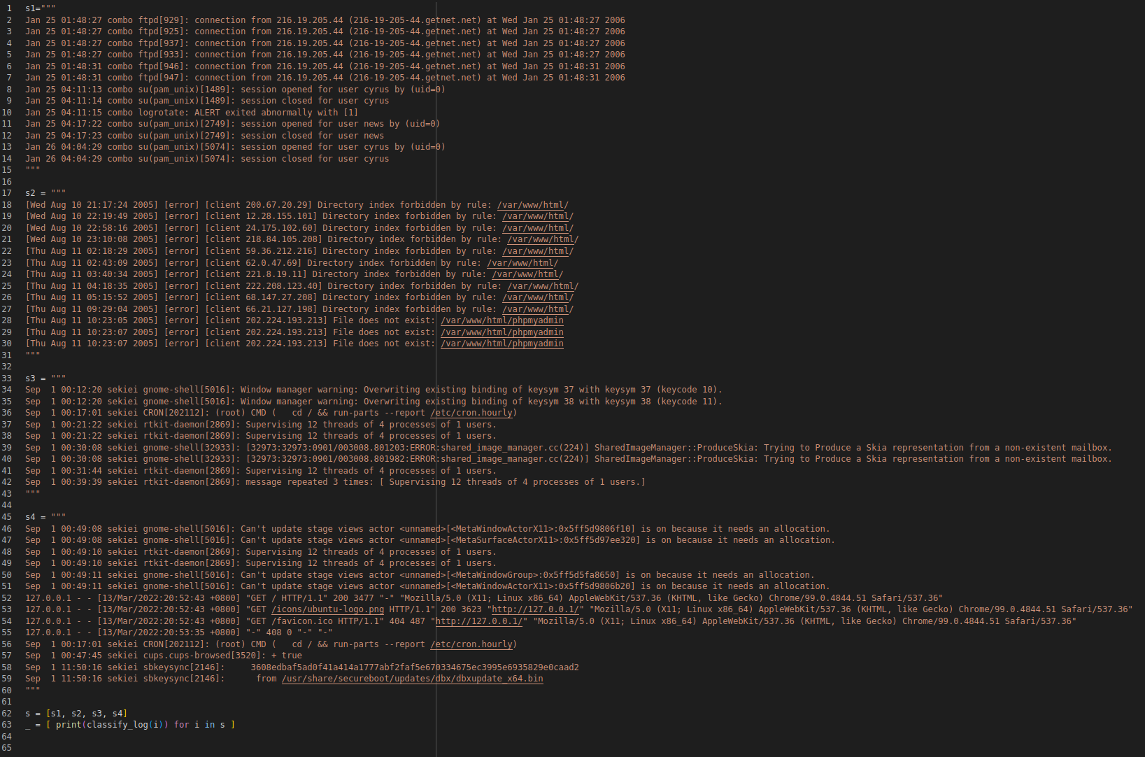
S1 ~ system messages log
S2 ~ web access_log log
S3 ~ system messages log from another source
S4 ~ mix of both system messages (first 6 & last 4 lines) and the rest web logs

Slide 25
A Better Method

Slide 26


Runtime Env

Slide 27
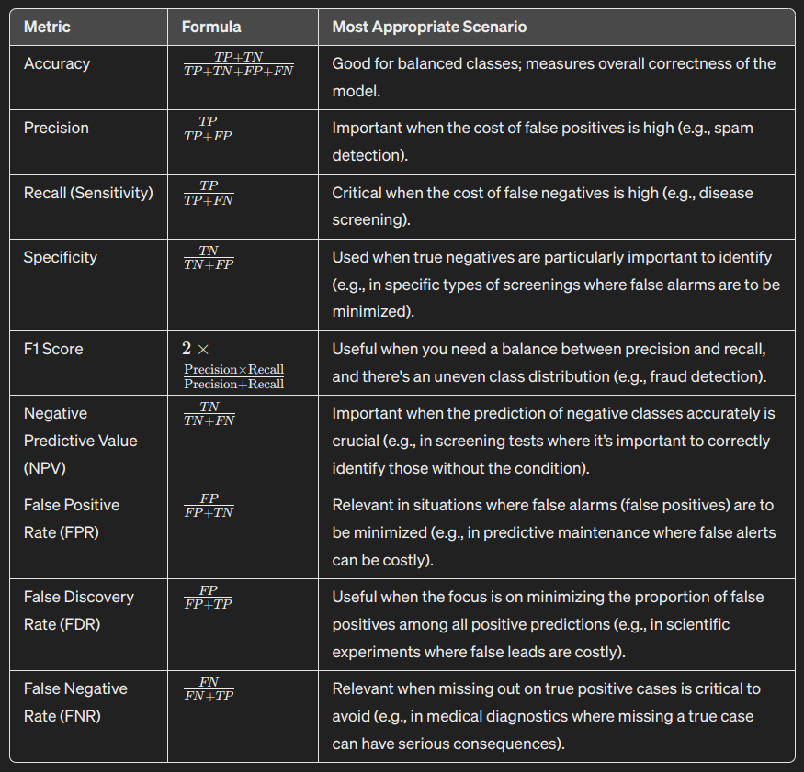

Slide 28
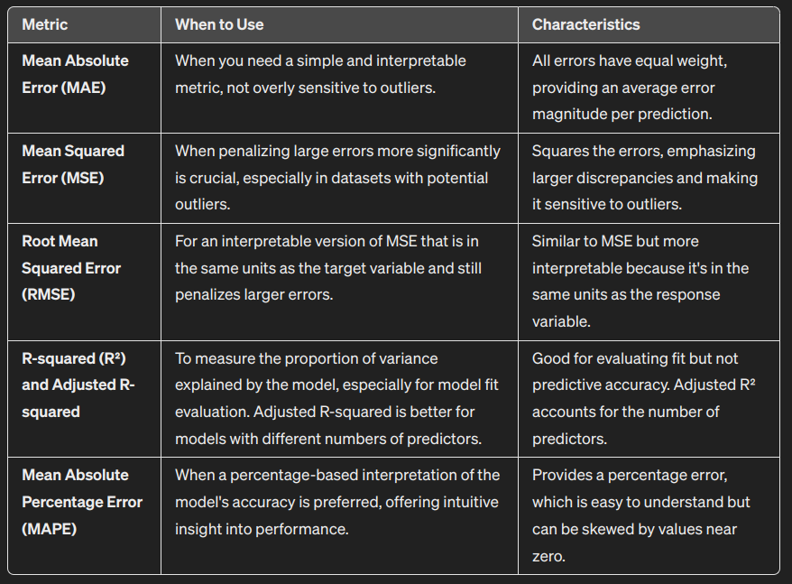

Slide 29
Visualization Demonstration
Key Insights: Visualization of feature importance, confusion matrices, and ROC curves to communicate findings.
Data-Driven Storytelling: Use visualizations to effectively convey the model's performance and insights.

Slide 30
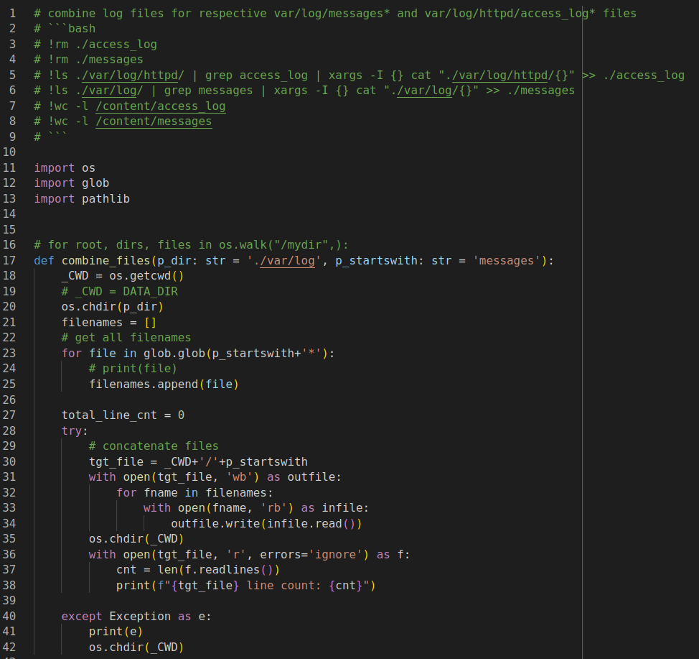
Coding and Implementation Highlights
As an academic exercise and to pythonic, a function (32 loc) was created to search for all same log types and combine into 1 file for processing later
however, this is not recommended, since the same results can be achieved in just 6 lines of bash code and probably faster using less memory

Slide 31
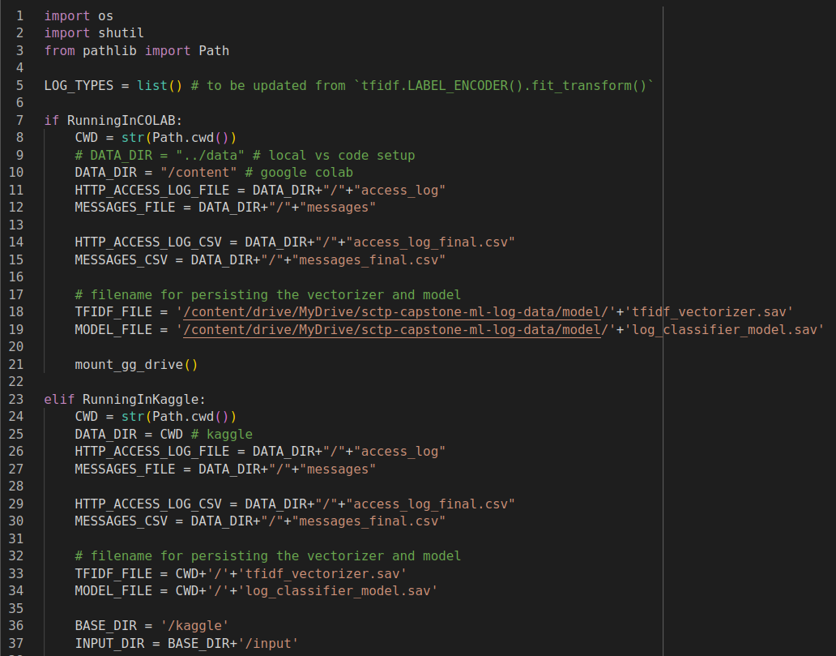
Coding and Implementation Highlights
Overall, I tried to adhere to some Coding Best Practices:
coding conventions (PEP-8) (not all the time)
modular programs such use of module functions to encapsulate logic for reusability and maintainability
notebook is structured for interoperability, ie allowing it to run both colab and kaggle, almost without modification
this is effectively achieve use of global variables initialized at the beginning

Slide 32
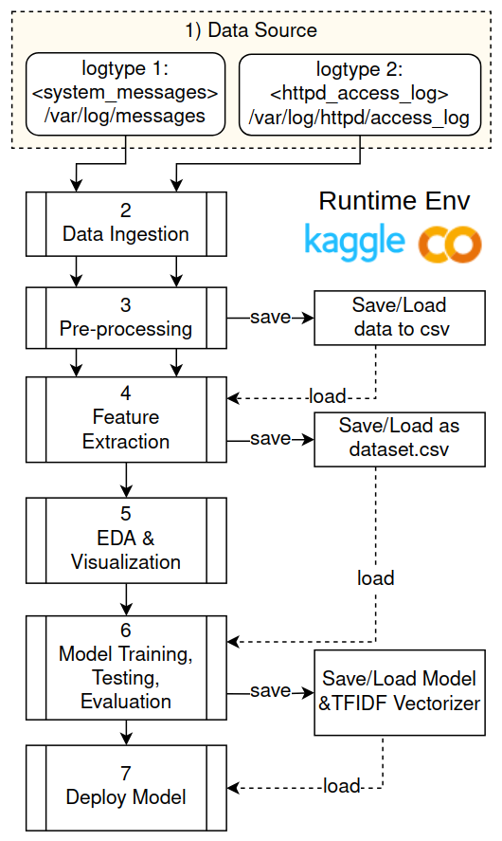
Challenges Faced and Problem-Solving Approach
Challenge #3: Erratic model results
Repeated execution of the notebook does not produce the same model outcome
Root Cause:
the resultant dataset used as input data for model training, file content varies, though the raw downloaded data remains the same
Fix:
file open as ‘wb’ (not ‘ab’)
emit file line count for better monitoring

Slide 33
Conclusion and Future Work
Key Achievements:
The Random Forest Classifier (RFC) model is able to achieve at least over 70% accuracy during validation (inference testing) vs 100% during training and testing
Given the the resource needed to train a RFC model is relatively light, we can quickly build a baseline model even on a laptop with 8 CPUs & 16GB RAM
Overall, the project has
enhanced my understanding of machine learning concepts, model (Random Forest) training and application on text
realized the disproportionate amount effort required prior to training the model, and to appreciate the value of tools like Kedro(kedro.org), AutoML(automl.org)...etc
demonstrated the possibility of true intelligent automation in IT
Going forward, the following are potential enhancements and extensions for future work, such as exploring other algorithms or incorporating additional features
why not try XGBoost as a comparison (enhancement)
use larger size input data, gathered from various sources (systems/servers/appliances…etc) (enhancement)
apply sentiment analysis on the log data to create a “Rating” feature that indicate different “severity” level, and probably explore using Time Series techniques to look into temporal patterns of this feature (extension)
apply deep learning techniques to discover structural patterns in logs (similar work: https://github.com/logpai/logparser) in order to make the data ingestion stage more flexible (extension)

